Slide 1
Insertion sort
Mack 2023
Notes:
Last updated: 28/09/2021
Resources are updated regularly — the latest version is available at: ncce.io/tcc.
This resource is licensed under the Open Government Licence, version 3. For more information on this licence, see ncce.io/ogl.

Slide 2

Where does this book go?
Starter activity
Given a list of books with the author names as above, where would you insert an additional book by George Orwell?
Think, write, pair, share.
Enid Blyton | Agatha Christie | Roald Dahl | Patrick Rothfuss | J.K. Rowling | J. R. R. Tolkien | Akira Toriyama | Virgina Woolf

Slide 3

Lesson 50: Insertion sort
Objectives
In this lesson, you will:
Insert an item into an ordered list of items
Describe how insertion sort is used for ordering a list of items
Perform an insertion sort to order a list containing sample data

Slide 4
Inserting an item
Activity 1
In the previous activity, you probably wouldn’t have added the new book to a random place in the list of books and then used a bubble sort to order the list.
Enid Blyton | Agatha Christie | Roald Dahl |  | Patrick Rothfuss | J.K. Rowling | J. R. R. Tolkien | Akira Toriyama | Virgina Woolf
George Orwell
It would make more sense to make space for the new book and insert it into the correct position in the list.
This is essentially how an insertion sort works.

Slide 5
Inserting an item
Activity 1
Imagine you are sorting a pack of cards into order. To add a card into the sorted list of cards you would probably do something like:
Retrieve a card from the unsorted pile.
Make room for the card in the sorted list.
Insert the card into the correct position in the list.

Slide 6

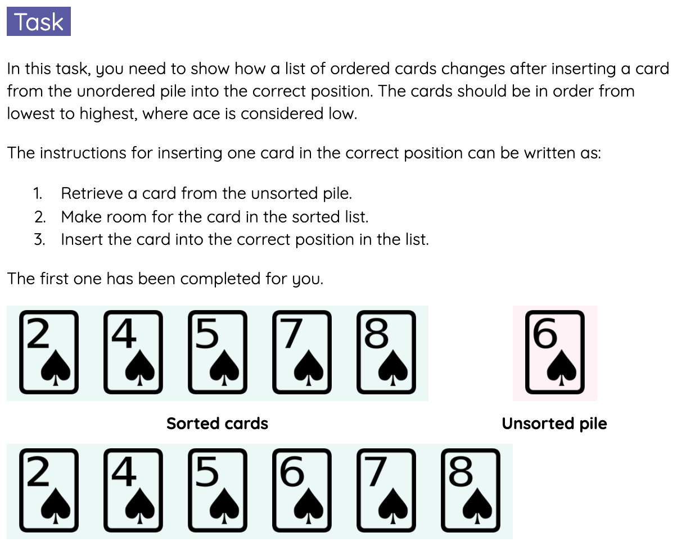
Inserting an item
Activity 1
Using the instructions in the previous slide, you are going to insert a card into a sorted list of cards.
Fill in the table on the Activity 1 worksheet to show the list of cards after one insertion.

Slide 7

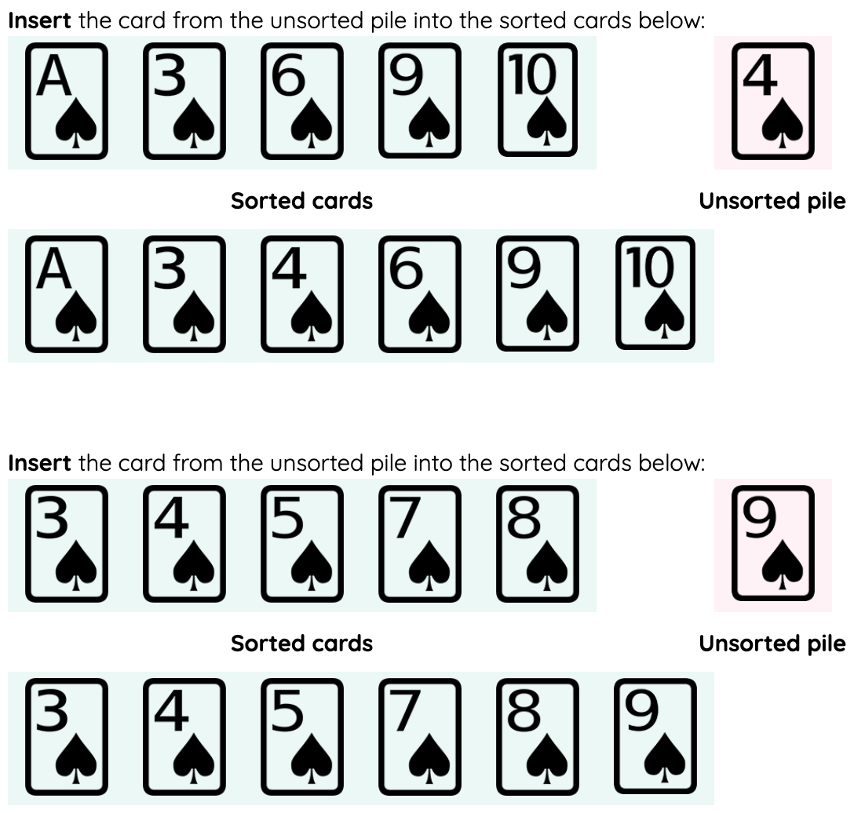
Inserting an item - Solution
Activity 1

Slide 8

Insertion sort
Activity 2
The insertion sort algorithm works by grouping the items in a list into two parts: a sorted sublist and an unsorted sublist.
With each pass through the list, an item from the unsorted sublist is compared to items in the sorted sublist until it is inserted into the correct position.
In the next slides, you will first see how the algorithm inserts one out-of-order item into the correct position in the list i.e. one pass of the algorithm.

Slide 9
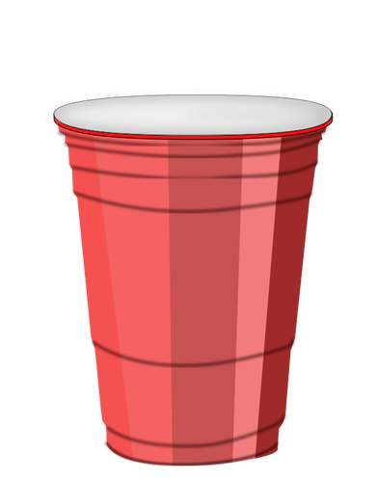
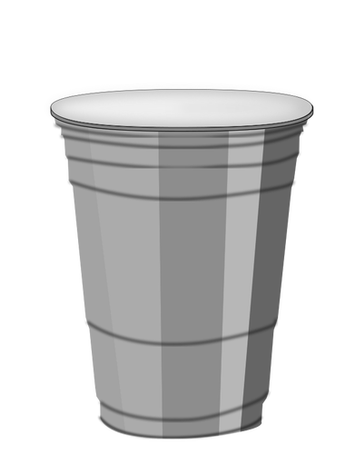
Insertion sort: single pass
Activity 2
Each number is hidden under a cup. The cups need to be sorted with the lowest value on the left.
Cup 1
Cup 2
Cup 3
Cup 4
Cup 5
Cup 6
Cup 7
2
21
43
80
sorted
unsorted
Take a list where the first items are ordered and the rest are not.
Notes:
Image source: https://publicdomainvectors.org/en/free-clipart/Plastic-cup-vector-drawing/8998.html

Slide 10
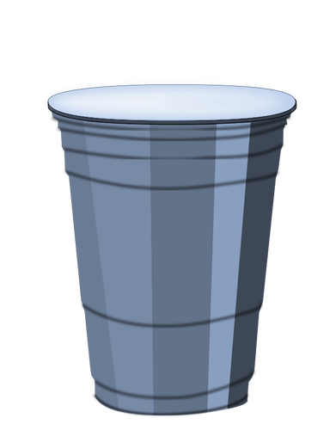
Insertion sort: single pass
Activity 2
Each number is hidden under a cup. The cups need to be sorted with the lowest value on the left.
Cup 1
Cup 2
Cup 3
Cup 4
Cup 5
Cup 6
Cup 7
2
21
43
80
sorted
unsorted
Take a list where the first items are ordered and the rest are not.
In each single pass, the first out-of-order item is inserted at the appropriate position in the sorted list.
Notes:
Image source: https://publicdomainvectors.org/en/free-clipart/Plastic-cup-vector-drawing/8998.html

Slide 11
Insertion sort: single pass
Activity 2
Each number is hidden under a cup. The cups need to be sorted with the lowest value on the left.
Cup 1
Cup 2
Cup 3
Cup 4
Cup 5
Cup 5
Cup 6
Cup 7
2
21
43
50
35
35
value
Copy the first out-of-order item into value.
Taking a copy of the last, out-of-order item is necessary. As items are “shifted” to the right, to make room for the new value, the last item in the list will be overwritten.

Slide 12
Insertion sort: single pass
Activity 2
Each number is hidden under a cup. The cups need to be sorted with the lowest value on the left.
Cup 1
Cup 2
Cup 3
Cup 4
Cup 5
Cup 6
Cup 7
2
21
43
50
35
35
current
value
Start with the last of the ordered items.

Slide 13
Insertion sort: single pass
Activity 2
Each number is hidden under a cup. The cups need to be sorted with the lowest value on the left.
Cup 1
Cup 2
Cup 3
Cup 4
Cup 5
Cup 6
Cup 7
2
21
43
80
35
35
current
value
If the item at the current position is greater than value,
copy it into the next item.
Move on to the previous item in the list.

Slide 14
Insertion sort: single pass
Activity 2
Each number is hidden under a cup. The cups need to be sorted with the lowest value on the left.
Cup 1
Cup 2
Cup 3
Cup 5
Cup 6
Cup 7
2
21
43
80
80
35
current
value
If the item at the current position is greater than value,
copy it into the next item.
Move on to the previous item in the list.

Slide 15
Insertion sort: single pass
Activity 2
Each number is hidden under a cup. The cups need to be sorted with the lowest value on the left.
Cup 1
Cup 2
Cup 3
Cup 4
Cup 5
Cup 6
Cup 7
2
21
43
50
50
35
current
value
If the item at the current position is greater than value,
copy it into the next item.
Move on to the previous item in the list.

Slide 16
Insertion sort: single pass
Activity 2
Each number is hidden under a cup. The cups need to be sorted with the lowest value on the left.
Cup 1
Cup 2
Cup 3
Cup 4
Cup 5
Cup 6
Cup 7
2
21
43
50
50
35
current
value
If the item at the current position is greater than value,
copy it into the next item.
Move on to the previous item in the list.

Slide 17
Insertion sort: single pass
Activity 2
Each number is hidden under a cup. The cups need to be sorted with the lowest value on the left.
Cup 1
Cup 2
Cup 3
Cup 4
Cup 5
Cup 6
Cup 7
2
21
43
43
50
35
current
value
If the item at the current position is greater than value,
copy it into the next item.
Move on to the previous item in the list.

Slide 18
Insertion sort: single pass
Activity 2
Each number is hidden under a cup. The cups need to be sorted with the lowest value on the left.
Cup 1
Cup 2
Cup 3
Cup 4
Cup 5
Cup 6
Cup 7
2
21
43
43
50
35
current
value
If the item at the current position is greater than value,
copy it into the next item.
Move on to the previous item in the list.

Slide 19
Insertion sort: single pass
Activity 2
Each number is hidden under a cup. The cups need to be sorted with the lowest value on the left.
Cup 1
Cup 2
Cup 3
Cup 4
Cup 5
Cup 6
Cup 7
2
21
43
43
50
35
current
value
If the item at the current position is not greater than value,
value is ready to be inserted in the list.

Slide 20
Insertion sort: single pass
Activity 2
Each number is hidden under a cup. The cups need to be sorted with the lowest value on the left.
Cup 1
Cup 2
Cup 3
Cup 4
Cup 5
Cup 6
Cup 7
2
21
35
43
50
35
current
value
Copy value into the item after the current position.

Slide 21
Insertion sort: single pass
Activity 2
Each number is hidden under a cup. The cups need to be sorted with the lowest value on the left.
Cup 1
Cup 2
Cup 3
Cup 4
Cup 5
Cup 6
Cup 7
2
21
35
43
80
35
sorted
unsorted
value
One pass has now been completed, increasing the sorted sublist by one item.

Slide 22
Algorithm for one pass of insertion sort
Activity 2
The instructions for executing one pass of insertion sort can be written as:
Take a list where the first items are ordered and the rest are not.
Copy the first out-of-order item into value.
Repeat steps a-b, starting from the last of the ordered items,
until no more items remain or value is ready to be inserted in the list:
If the item at the current position is greater than value,
copy it into the next item. Move on to the previous item in the list.
Otherwise, value is ready to be inserted in the list.
Copy value into the item after the current position.
Pass

Slide 23
Insertion sort: multiple passes
Activity 3
Now that you have seen how one pass of an insertion sort works, the next slides will go through multiple passes to show you how a complete insertion sort is executed.

Slide 24
Insertion sort: multiple passes
Activity 3
Each number is hidden under a cup. The cups need to be sorted with the lowest value on the left.
Cup 1
Cup 2
Cup 3
Cup 4
Cup 5
Cup 6
Take a list of data to be sorted.
Notes:
Image source: https://publicdomainvectors.org/en/free-clipart/Plastic-cup-vector-drawing/8998.html

Slide 25
Insertion sort: multiple passes
Activity 3
Each number is hidden under a cup. The cups need to be sorted with the lowest value on the left.
Cup 1
Cup 2
Cup 3
Cup 4
Cup 5
Cup 6
sorted
unsorted
Let the unsorted sublist contain all the items, except the first one.
Notes:
Image source: https://publicdomainvectors.org/en/free-clipart/Plastic-cup-vector-drawing/8998.html

Slide 26
Insertion sort: multiple passes
Activity 3
Each number is hidden under a cup. The cups need to be sorted with the lowest value on the left.
Cup 1
Cup 2
Cup 3
Cup 4
Cup 5
Cup 6
43
21
sorted
unsorted
In the first pass, the first out-of-order item will be inserted at the appropriate position in the sorted list.
Notes:
Image source: https://publicdomainvectors.org/en/free-clipart/Plastic-cup-vector-drawing/8998.html

Slide 27
Insertion sort: multiple passes
Activity 3
Each number is hidden under a cup. The cups need to be sorted with the lowest value on the left.
Cup 1
Cup 3
Cup 4
Cup 5
Cup 6
43
21
Retrieve the first out-of-order item,
compare it to the items in the ordered list and
“shift” these items until the new item is inserted into the correct position.
Notes:
Image source: https://publicdomainvectors.org/en/free-clipart/Plastic-cup-vector-drawing/8998.html

Slide 28
Insertion sort: multiple passes
Activity 3
Each number is hidden under a cup. The cups need to be sorted with the lowest value on the left.
Cup 1
Cup 3
Cup 4
Cup 5
Cup 6
43
21
Retrieve the first out-of-order item,
compare it to the items in the ordered list and
“shift” these items until the new item is inserted into the correct position.
Notes:
Image source: https://publicdomainvectors.org/en/free-clipart/Plastic-cup-vector-drawing/8998.html

Slide 29
Insertion sort: multiple passes
Activity 3
Each number is hidden under a cup. The cups need to be sorted with the lowest value on the left.
Cup 3
Cup 4
Cup 5
Cup 6
21
43
Retrieve the first out-of-order item,
compare it to the items in the ordered list and
“shift” these items until the new item is inserted into the correct position.
Notes:
Image source: https://publicdomainvectors.org/en/free-clipart/Plastic-cup-vector-drawing/8998.html

Slide 30
Insertion sort: multiple passes
Activity 3
Each number is hidden under a cup. The cups need to be sorted with the lowest value on the left.
Cup 3
Cup 4
Cup 5
Cup 6
21
43
sorted
unsorted
One pass has now been completed, increasing the sorted sublist by one item.
Notes:
Image source: https://publicdomainvectors.org/en/free-clipart/Plastic-cup-vector-drawing/8998.html

Slide 31
Insertion sort: multiple passes
Activity 3
Each number is hidden under a cup. The cups need to be sorted with the lowest value on the left.
Cup 1
Cup 2
Cup 3
Cup 4
Cup 5
Cup 6
21
43
2
sorted
unsorted
In the next pass, the first out-of-order item will be inserted at the appropriate position in the sorted list.
Notes:
Image source: https://publicdomainvectors.org/en/free-clipart/Plastic-cup-vector-drawing/8998.html

Slide 32
Insertion sort: multiple passes
Activity 3
Each number is hidden under a cup. The cups need to be sorted with the lowest value on the left.
Cup 1
Cup 2
Cup 3
Cup 4
Cup 5
Cup 6
21
43
2
Retrieve the first out-of-order item,
compare it to the items in the ordered list and
“shift” these items until the new item is inserted into the correct position.
Notes:
Image source: https://publicdomainvectors.org/en/free-clipart/Plastic-cup-vector-drawing/8998.html

Slide 33
Insertion sort: multiple passes
Activity 3
Each number is hidden under a cup. The cups need to be sorted with the lowest value on the left.
Cup 1
Cup 2
Cup 3
Cup 4
Cup 5
Cup 6
21
43
2
Retrieve the first out-of-order item,
compare it to the items in the ordered list and
“shift” these items until the new item is inserted into the correct position.
Notes:
Image source: https://publicdomainvectors.org/en/free-clipart/Plastic-cup-vector-drawing/8998.html

Slide 34
Insertion sort: multiple passes
Activity 3
Each number is hidden under a cup. The cups need to be sorted with the lowest value on the left.
Cup 1
Cup 2
Cup 3
Cup 4
Cup 5
Cup 6
2
21
43
Retrieve the first out-of-order item,
compare it to the items in the ordered list and
“shift” these items until the new item is inserted into the correct position.
Notes:
Image source: https://publicdomainvectors.org/en/free-clipart/Plastic-cup-vector-drawing/8998.html

Slide 35
Insertion sort: multiple passes
Activity 3
Each number is hidden under a cup. The cups need to be sorted with the lowest value on the left.
Cup 1
Cup 2
Cup 3
Cup 4
Cup 5
Cup 6
2
21
43
sorted
unsorted
One pass has now been completed, increasing the sorted sublist by one item.
Notes:
Image source: https://publicdomainvectors.org/en/free-clipart/Plastic-cup-vector-drawing/8998.html

Slide 36
Insertion sort: multiple passes
Activity 3
Each number is hidden under a cup. The cups need to be sorted with the lowest value on the left.
Cup 1
Cup 2
Cup 3
Cup 4
Cup 5
Cup 6
2
21
43
50
sorted
unsorted
In the next pass, the first out-of-order item will be inserted at the appropriate position in the sorted list.
Notes:
Image source: https://publicdomainvectors.org/en/free-clipart/Plastic-cup-vector-drawing/8998.html

Slide 37
Insertion sort: multiple passes
Activity 3
Each number is hidden under a cup. The cups need to be sorted with the lowest value on the left.
Cup 1
Cup 2
Cup 3
Cup 4
Cup 5
Cup 6
2
21
43
80
Retrieve the first out-of-order item,
compare it to the items in the ordered list and
“shift” these items until the new item is inserted into the correct position.
Notes:
Image source: https://publicdomainvectors.org/en/free-clipart/Plastic-cup-vector-drawing/8998.html

Slide 38
Insertion sort: multiple passes
Activity 3
Each number is hidden under a cup. The cups need to be sorted with the lowest value on the left.
Cup 1
Cup 2
Cup 3
Cup 4
Cup 5
Cup 6
2
21
43
80
Retrieve the first out-of-order item,
compare it to the items in the ordered list and
“shift” these items until the new item is inserted into the correct position.
Notes:
Image source: https://publicdomainvectors.org/en/free-clipart/Plastic-cup-vector-drawing/8998.html

Slide 39
Insertion sort: multiple passes
Activity 3
Each number is hidden under a cup. The cups need to be sorted with the lowest value on the left.
Cup 1
Cup 2
Cup 3
Cup 4
Cup 5
Cup 6
2
21
43
80
Retrieve the first out-of-order item,
compare it to the items in the ordered list and
“shift” these items until the new item is inserted into the correct position.
Notes:
Image source: https://publicdomainvectors.org/en/free-clipart/Plastic-cup-vector-drawing/8998.html

Slide 40
Insertion sort: multiple passes
Activity 3
Each number is hidden under a cup. The cups need to be sorted with the lowest value on the left.
Cup 1
Cup 2
Cup 3
Cup 4
Cup 5
Cup 6
2
21
43
80
sorted
unsorted
One pass has now been completed, increasing the sorted sublist by one item.
Notes:
Image source: https://publicdomainvectors.org/en/free-clipart/Plastic-cup-vector-drawing/8998.html

Slide 41
Insertion sort: multiple passes
Activity 3
Each number is hidden under a cup. The cups need to be sorted with the lowest value on the left.
Cup 1
Cup 2
Cup 3
Cup 4
Cup 5
Cup 6
2
21
43
80
3
sorted
unsorted
In the next pass, the first out-of-order item will be inserted at the appropriate position in the sorted list.
Notes:
Image source: https://publicdomainvectors.org/en/free-clipart/Plastic-cup-vector-drawing/8998.html

Slide 42
Insertion sort: multiple passes
Activity 3
Each number is hidden under a cup. The cups need to be sorted with the lowest value on the left.
Cup 1
Cup 2
Cup 3
Cup 4
Cup 5
Cup 6
2
21
43
80
3
Retrieve the first out-of-order item,
compare it to the items in the ordered list and
“shift” these items until the new item is inserted into the correct position.
Notes:
Image source: https://publicdomainvectors.org/en/free-clipart/Plastic-cup-vector-drawing/8998.html

Slide 43
Insertion sort: multiple passes
Activity 3
Each number is hidden under a cup. The cups need to be sorted with the lowest value on the left.
Cup 1
Cup 2
Cup 3
Cup 4
Cup 5
Cup 6
2
21
43
80
3
Retrieve the first out-of-order item,
compare it to the items in the ordered list and
“shift” these items until the new item is inserted into the correct position.
Notes:
Image source: https://publicdomainvectors.org/en/free-clipart/Plastic-cup-vector-drawing/8998.html

Slide 44
Insertion sort: multiple passes
Activity 3
Each number is hidden under a cup. The cups need to be sorted with the lowest value on the left.
Cup 1
Cup 2
Cup 3
Cup 4
Cup 5
Cup 6
2
3
21
43
80
Retrieve the first out-of-order item,
compare it to the items in the ordered list and
“shift” these items until the new item is inserted into the correct position.
Notes:
Image source: https://publicdomainvectors.org/en/free-clipart/Plastic-cup-vector-drawing/8998.html

Slide 45
Insertion sort: multiple passes
Activity 3
Each number is hidden under a cup. The cups need to be sorted with the lowest value on the left.
Cup 1
Cup 2
Cup 3
Cup 4
Cup 5
Cup 6
2
3
21
43
80
sorted
unsorted
One pass has now been completed, increasing the sorted sublist by one item.
Notes:
Image source: https://publicdomainvectors.org/en/free-clipart/Plastic-cup-vector-drawing/8998.html

Slide 46
Insertion sort: multiple passes
Activity 3
Each number is hidden under a cup. The cups need to be sorted with the lowest value on the left.
Cup 1
Cup 2
Cup 3
Cup 4
Cup 5
Cup 6
2
3
21
43
80
35
sorted
unsorted
In the next pass, the last remaining out-of-order item will be inserted at the appropriate position in the sorted list.
Notes:
Image source: https://publicdomainvectors.org/en/free-clipart/Plastic-cup-vector-drawing/8998.html

Slide 47
Insertion sort: multiple passes
Activity 3
Each number is hidden under a cup. The cups need to be sorted with the lowest value on the left.
Cup 1
Cup 2
Cup 3
Cup 4
Cup 5
Cup 6
2
3
21
43
80
35
Retrieve the first out-of-order item,
compare it to the items in the ordered list and
“shift” these items until the new item is inserted into the correct position.
Notes:
Image source: https://publicdomainvectors.org/en/free-clipart/Plastic-cup-vector-drawing/8998.html

Slide 48
Insertion sort: multiple passes
Activity 3
Each number is hidden under a cup. The cups need to be sorted with the lowest value on the left.
Cup 1
Cup 2
Cup 3
Cup 4
Cup 5
Cup 6
2
3
21
43
80
35
Retrieve the first out-of-order item,
compare it to the items in the ordered list and
“shift” these items until the new item is inserted into the correct position.
Notes:
Image source: https://publicdomainvectors.org/en/free-clipart/Plastic-cup-vector-drawing/8998.html

Slide 49
Insertion sort: multiple passes
Activity 3
Each number is hidden under a cup. The cups need to be sorted with the lowest value on the left.
Cup 1
Cup 2
Cup 3
Cup 4
Cup 5
Cup 6
2
3
21
35
43
80
Retrieve the first out-of-order item,
compare it to the items in the ordered list and
“shift” these items until the new item is inserted into the correct position.
Notes:
Image source: https://publicdomainvectors.org/en/free-clipart/Plastic-cup-vector-drawing/8998.html

Slide 50
Insertion sort: multiple passes
Activity 3
Each number is hidden under a cup. The cups need to be sorted with the lowest value on the left.
Cup 1
Cup 2
Cup 3
Cup 4
Cup 5
Cup 6
2
3
21
35
43
80
sorted
One pass has now been completed and the list of items is now ordered.
Notes:
Image source: https://publicdomainvectors.org/en/free-clipart/Plastic-cup-vector-drawing/8998.html

Slide 51
Algorithm for a complete insertion sort
Activity 3
The instructions for executing an insertion sort in full can be written as:
Take a list of data to be sorted.
Let the unsorted sublist contain all the items, except the first one.
Repeat steps 1-3 (the pass) until the unsorted list is empty:
Copy the first out-of-order item into value.
Repeat steps a-b, starting from the last of the ordered items,
until no more items remain or value is ready to be inserted in the list:
If the item at the current position is greater than value,
copy it into the next item. Move on to the previous item in the list.
Otherwise, value is ready to be inserted in the list.
Copy value into the item after the current position.
Pass

Slide 52
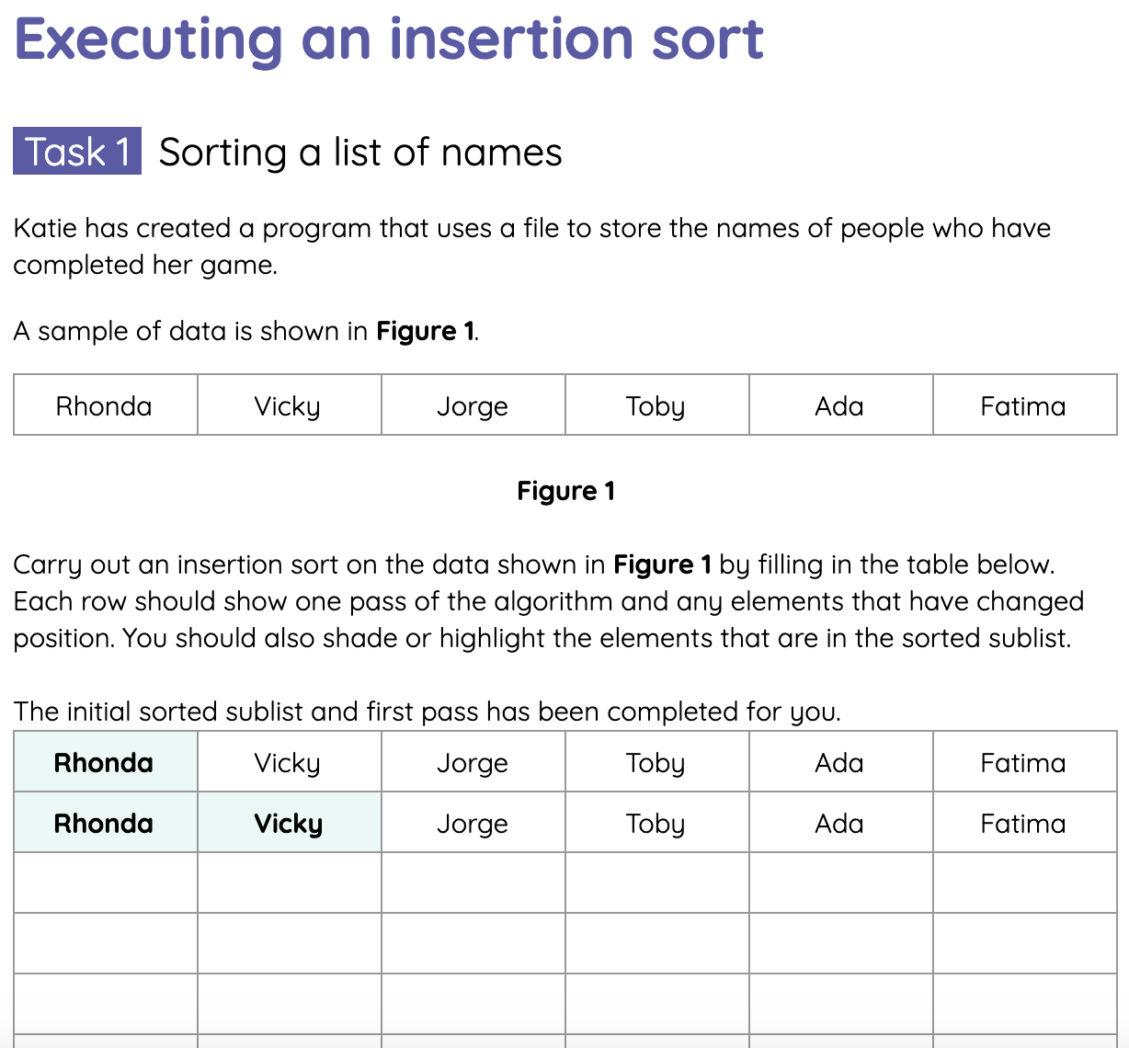
Executing an insertion sort
Activity 4
Complete the tasks on the Activity 4 worksheet for executing an insertion sort.

Slide 53
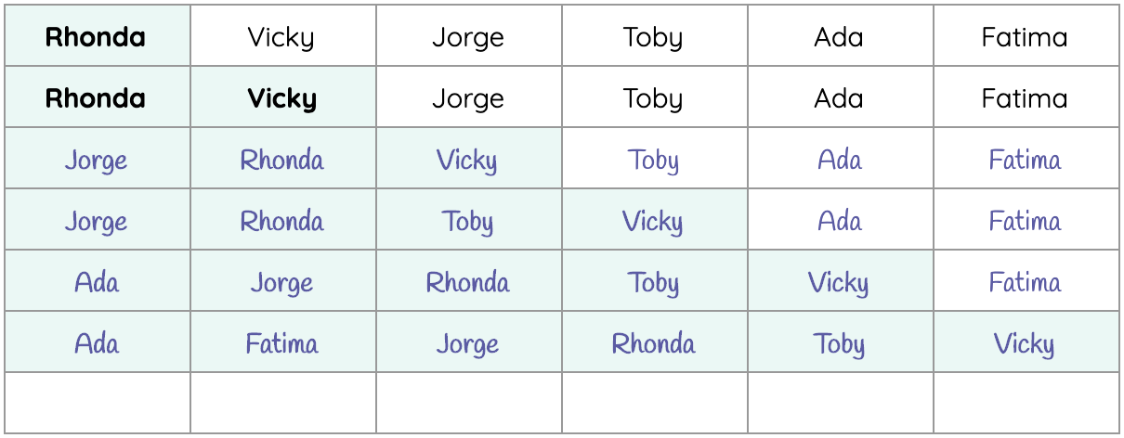
Executing an insertion sort
Activity 4
Below is the solution for each pass of the insertion sort in the first task:

Slide 54
Comparing insertion sort to bubble sort
Activity 5
You may have noticed that an insertion sort passes over the list a similar amount of times to bubble sort.
However, an insertion sort usually involves less comparisons per pass.
This means that insertion sort is generally quicker to execute than bubble sort, especially on large data sets.

Slide 55

Summary of insertion sort
Wrap Up
An insertion sort groups the items of a list into two parts: a sorted sublist and an unsorted sublist.
The algorithm takes each item from the unsorted sublist, compares it to the items in the sorted sublist and places it in the correct position.
People often perform an insertion sort when they are putting objects into order, like books or cards.

Slide 56
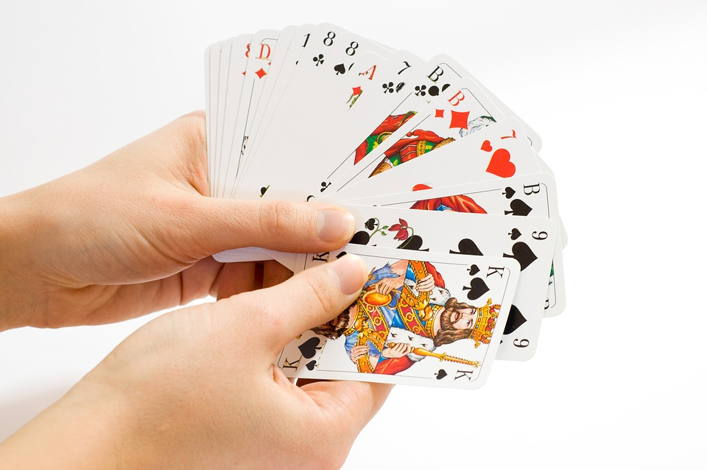
Homework: Describing insertion sort
Homework
In your own words, write the instructions for carrying out an insertion sort on a pack of cards.
Anyone should be able to follow these steps without needing to know about insertion sort beforehand.
Due: Next lesson
Notes:
Image source: https://pixabay.com/photos/card-game-cards-gambling-game-1834640/

Slide 57
Next lesson
Summary
In this lesson, you…
Inserted an item into an ordered list of items.
Described how insertion sort is used for ordering a list of items.
Performed an insertion sort to order a list containing sample data.
Next lesson, you will…
Analyse and interpret Python code for bubble sort and insertion sort.

